Slide 1
KNN algorithm

Slide 2
Introduction
KNN is a non-parametric and lazy learning algorithm.
Non-parametric means there is no assumption for underlying data distribution. In other words, the model structure determined from the dataset. This will be very helpful in practice where most of the real world datasets do not follow mathematical theoretical assumptions.
Lazy algorithm means it does not need any training data points for model generation. All training data used in the testing phase. This makes training faster and testing phase slower and costlier. Costly testing phase means time and memory. In the worst case, KNN needs more time to scan all data points and scanning all data points will require more memory for storing training data.
KNN can be used for both classification and regression predictive problems. However, it is more widely used in classification problems in the industry.
KNN performs better with a lower number of features than a large number of features. Increase in dimension also leads to the problem of overfitting.

Slide 3
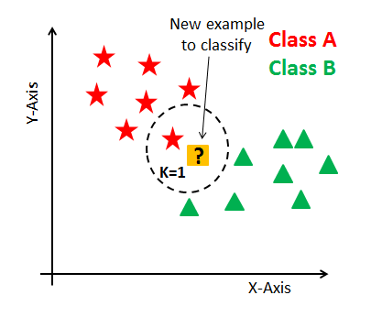
In KNN, K is the number of nearest neighbors. The number of neighbors is the core deciding factor.
K is generally an odd number if the number of classes is 2. When K=1, then the algorithm is known as the nearest neighbor algorithm. This is the simplest case. Suppose P1 is the point, for which label needs to predict. First, you find the one closest point to P1 and then the label of the nearest point assigned to P1.

Slide 4
Suppose P1 is the point, for which label needs to predict. First, you find the k closest point to P1 and then classify points by majority vote of its k neighbors.
Each object votes for their class and the class with the most votes is taken as the prediction. For finding closest similar points, you find the distance between points using distance measures such as Euclidean distance, Hamming distance, Manhattan distance and Minikowski distance. KNN has the following basic steps:
Calculate distance
Find closest neighbors
Vote for labels

Slide 5
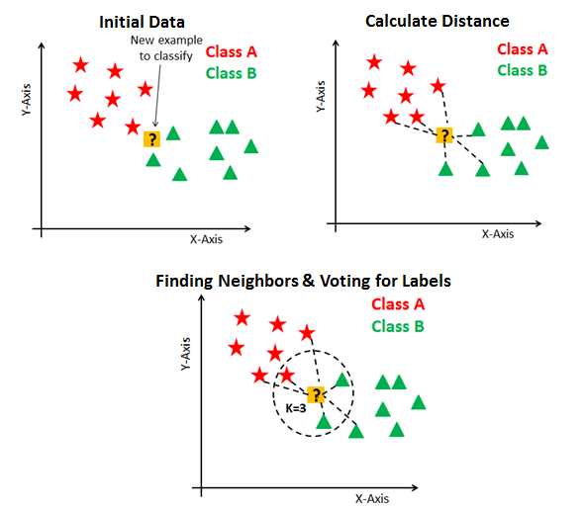

Slide 6
K-NN Assumptions
Dataset has little noise.
Dataset is labeled.
Dataset only contain relevant features.
Avoid k-NN on large datasets.It would probably take long time.

Slide 7
Eager Vs Lazy Learners
Eager learners mean when given training points will construct a generalized model before performing prediction on given new points to classify. You can think of such learners as being ready, active and eager to classify unobserved data points.
Lazy Learning means there is no need for learning or training of the model and all of the data points used at the time of prediction.
Lazy learners wait until the last minute before classifying any data point.
Lazy learner stores merely the training dataset and waits until classification needs to perform.
Only when it sees the test tuple does it perform generalization to classify the tuple based on its similarity to the stored training tuples.
Unlike eager learning methods, lazy learners do less work in the training phase and more work in the testing phase to make a classification.
Lazy learners are also known as instance-based learners because lazy learners store the training points or instances, and all learning is based on instances.

Slide 8
How do you decide the number of neighbors in KNN?
The number of neighbors(K) in KNN is a hyperparameter that you need choose at the time of model building. You can think of K as a controlling variable for the prediction model.
No optimal number of neighbors suits all kind of data sets. Each dataset has it's own requirements. In the case of a small number of neighbors, the noise will have a higher influence on the result, and a large number of neighbors make it computationally expensive.
Research has also shown that a small amount of neighbors are most flexible fit which will have low bias but high variance and a large number of neighbors will have a smoother decision boundary which means lower variance but higher bias.
Generally, Data scientists choose as an odd number if the number of classes is even. You can also check by generating the model on different values of k and check their performance. You can also try Elbow method here.

Slide 9
Choosing the right value of K
To select the K that’s right for your data, we run the KNN algorithm several times with different values of K and choose the K that reduces the number of errors we encounter while maintaining the algorithm’s ability to accurately make predictions when it’s given data it hasn’t seen before.
As we decrease the value of K to 1, our predictions become less stable.
Inversely, as we increase the value of K, our predictions become more stable due to majority voting / averaging, and thus, more likely to make more accurate predictions (up to a certain point). Eventually, we begin to witness an increasing number of errors. It is at this point we know we have pushed the value of K too far.
In cases where we are taking a majority vote (e.g. picking the mode in a classification problem) among labels, we usually make K an odd number to have a tiebreaker.
Cross-validation is a smart way to find out the optimal K value. It estimates the validation error rate by holding out a subset of the training set from the model building process.
Cross-validation (let's say 10 fold validation) involves randomly dividing the training set into 10 groups, or folds, of approximately equal size. 90% data is used to train the model and remaining 10% to validate it. The misclassification rate is then computed on the 10% validation data. This procedure repeats 10 times. Different group of observations are treated as a validation set each of the 10 times. It results to 10 estimates of the validation error which are then averaged out.

Slide 10
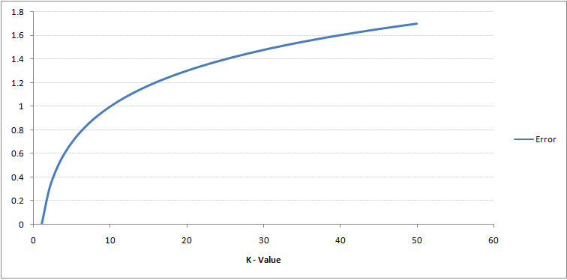
Curve for the training error rate with a varying value of K :
The error rate at K=1 is always zero for the training sample. This is because the closest point to any training data point is itself.Hence the prediction is always accurate with K=1.

Slide 11
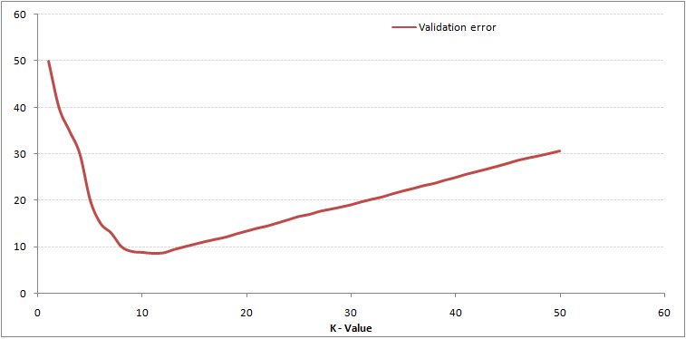
Validation Error Curve
If validation error curve would have been similar, our choice of K would have been 1. Following is the validation error curve with varying value of K:
At K=1, we were overfitting the boundaries. Hence, error rate initially decreases and reaches a minima. After the minima point, it then increase with increasing K. To get the optimal value of K, you can segregate the training and validation from the initial dataset.
Now plot the validation error curve to get the optimal value of K. This value of K should be used for all predictions.
This curve is known as an ‘elbow curve‘ (because it has a shape like an elbow) and is usually used to determine the k value.

Slide 12
KNN steps
Load the data
Initialize K to your chosen number of neighbours
For each example in the data
Calculate the distance between the query example and the current example from the data.
Add the distance and the index of the example to an ordered collection
Sort the ordered collection of distances and indices from smallest to largest (in ascending order) by the distances
Pick the first K entries from the sorted collection
Get the labels of the selected K entries
If regression, return the mean of the K labels.
If classification, return the mode of the K labels

Slide 13
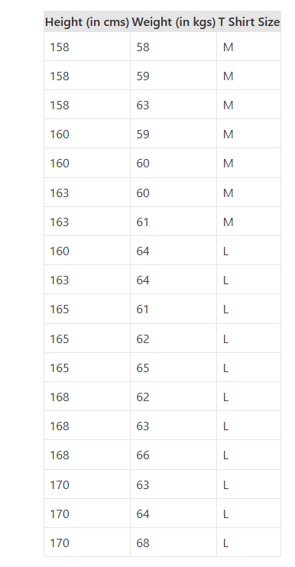
Example
We need to predict the T-shirt size of a new customer given only height and weight information we have. Data including height, weight and T-shirt size information is shown below -

Slide 14
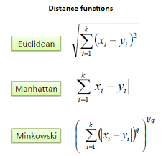
Calculate Similarity based on distance function
There are many distance functions but Euclidean is the most commonly used measure. It is mainly used when data is continuous.
Manhattan distance is also very common for continuous variables.
There are other similarity/distance measures for different types of data also.

Slide 15
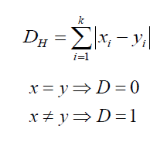
Distance measures for categorical variables
Hamming Distance: It is used for categorical variables. If the value (x) and the value (y) are the same, the distance D will be equal to 0 . Otherwise D=1.

Slide 16

Lets say New customer named has height 161cm and weight 61kg.
Euclidean distance between first observation and new observation is as follows –
Similarly, we will calculate distance of all the training cases with new case and calculates the rank in terms of distance. The smallest distance value will be ranked 1 and considered as nearest neighbor.

Slide 17
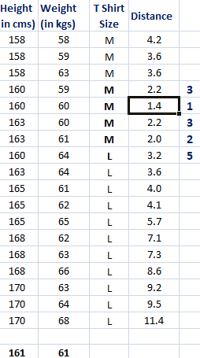
Find K-Nearest Neighbors & Sort in ascending order
Let k be 5. Then the algorithm searches for the 5 customers closest to new observation see what categories those 5 customers were in.

Slide 18
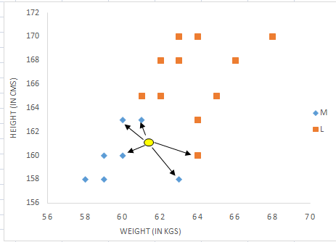
Predict the class based on majority voting(in case of regression: average of the class values) Visual interpretation
In the snapshot , binary dependent variable (T-shirt size) is displayed in blue and orange color. 'Medium T-shirt size' is in blue color and 'Large T-shirt size' in orange color.
New customer information is exhibited in yellow circle. Four blue highlighted data points and one orange highlighted data point are close to yellow circle.
So the prediction for the new case is blue highlighted data point which is Medium T-shirt size.

Slide 19
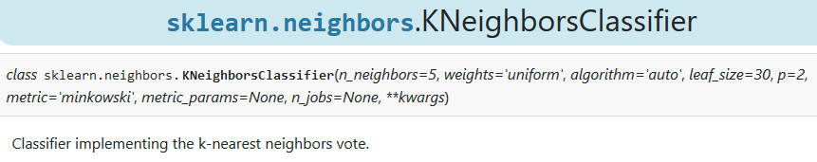
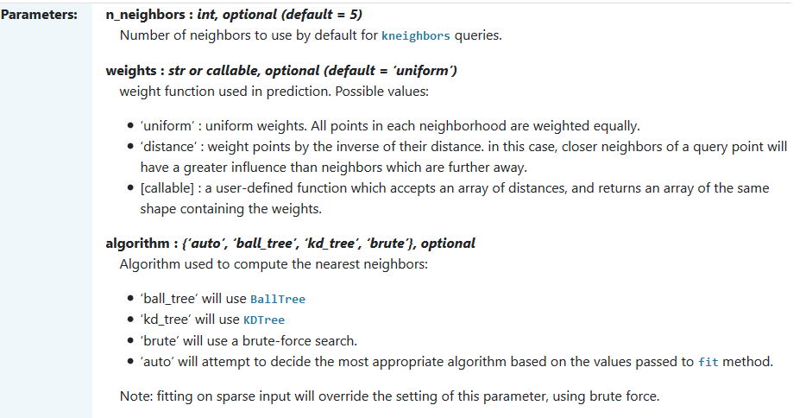

Slide 20
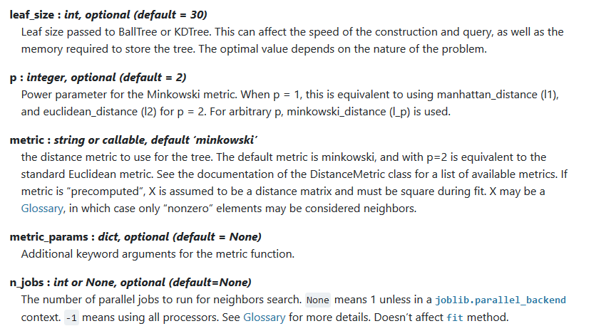

Slide 21
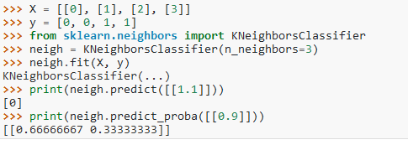
Simple python implementation

Slide 22
Advantages
It is extremely easy to implement
As said earlier, it is lazy learning algorithm and therefore requires no training prior to making real time predictions. This makes the KNN algorithm much faster than other algorithms that require training e.g SVM, linear regression, etc.
Since the algorithm requires no training before making predictions, new data can be added seamlessly.
There are only two parameters required to implement KNN i.e. the value of K and the distance function (e.g. Euclidean or Manhattan etc.)

Slide 23
Disadvantages
The KNN algorithm doesn't work well with high dimensional data because with large number of dimensions, it becomes difficult for the algorithm to calculate distance in each dimension.
The KNN algorithm has a high prediction cost for large datasets. This is because in large datasets the cost of calculating distance between new point and each existing point becomes higher.
Finally, the KNN algorithm doesn't work well with categorical features since it is difficult to find the distance between dimensions with categorical features.

Slide 24
Conclusion
KNN is a simple yet powerful classification algorithm.
It requires no training for making predictions, which is typically one of the most difficult parts of a machine learning algorithm.
The KNN algorithm have been widely used to find document similarity and pattern recognition.
It has also been employed for developing recommender systems and for dimensionality reduction and pre-processing steps for computer vision, particularly face recognition tasks.

Slide 25
Thank You

